Slide 1
Visual Studio 2019

Slide 2




Special Thanks To Our Sponsors

Slide 3
Link to Slides and Demos
https://github.com/NYCDotNetDevs/VisualStudio2019

Slide 4
Overview
Changes to VS Editions
Developer Community
UI Productivity Changes
Manage Pull Requests
Code Clean Up
IntelliCode
Debugging Improvements
Live Share

Slide 5
Overview
Xamarin
.NET Core 3.0
.NET 5
Blazor
WSL
C#8.0
Spark.NET
Chromium Edge
ML.NET

Slide 6
Changes to VS Editions
Community
Still free for up to 5 developers
CodeLens (References, Application Insights, Test) now included!

Slide 7
Developer Community
Report a Problem
Suggest New Feature
Feedback Site

Slide 8
Demo

Slide 9
UI Productivity Changes
Export/Import Installation Settings
New Start Window
Search bar
Solution Filters

Slide 10
Demo

Slide 11
Manage Pull Requests
See a history of changes as you code
Make live edits and set breakpoints in the diff view
Create new Pull Requests on Azure Repos
Review and checkout Pull Requests from Azure Repos
Add Likes, make comments over any span of code and use full markdown

Slide 12
Demo

Slide 13
Code Clean Up
You can now clean up your code utilizing the code style settings in one-click

Slide 14
Demo

Slide 15
IntelliCode
An extension that enhances your software development efforts by using artificial intelligence.
IntelliSense + AI = IntelliCode
AI-assisted IntelliSense recommendations based on your own code (C# only) (Preview)

Slide 16
Demo

Slide 17
Debugging Improvements
Up to 50% faster stepping through code
Search your locals and watch windows

Slide 18
Demo

Slide 19
Live Share
Live editing
Group debugging
Focus and Follow
Shared servers
Audio calls
Shared terminal

Slide 20
Demo

Slide 21

Xamarin
Xamarin.Forms 4.0:
Visual
CollectionView
CarouselView
Shell
Android Build Times Improved
Xamarin API docs are now open source
Xamarin University courses are now on Microsoft Learn

Slide 22
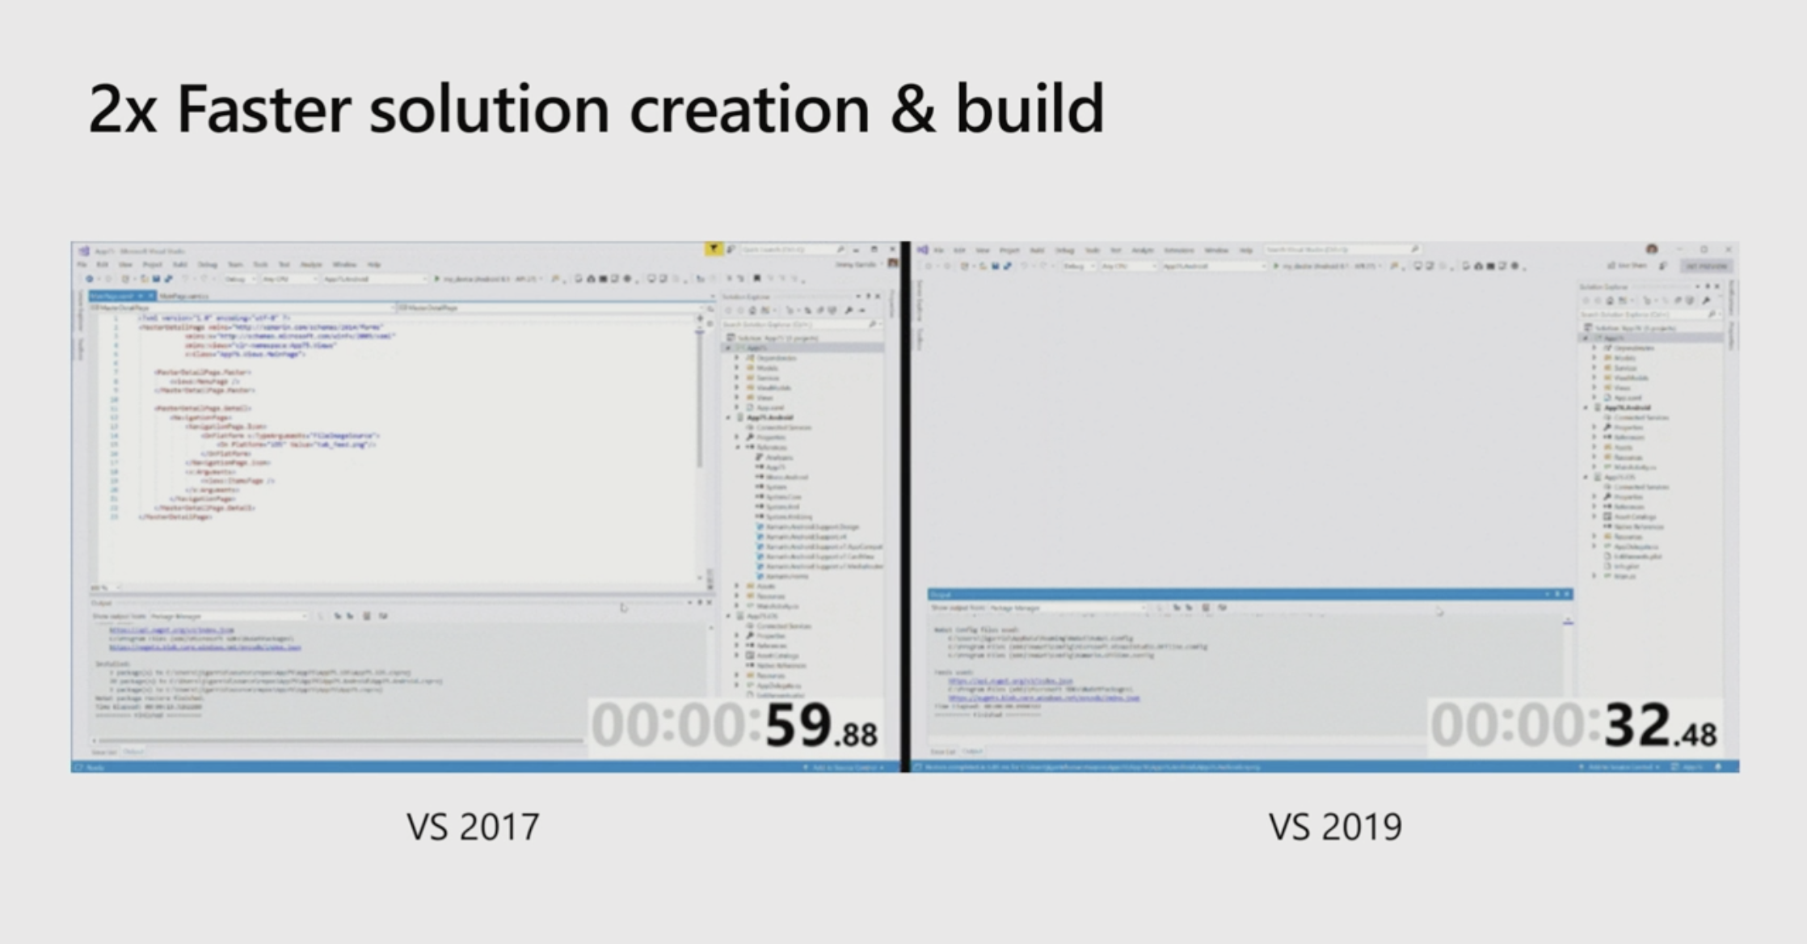
Xamarin

Slide 23
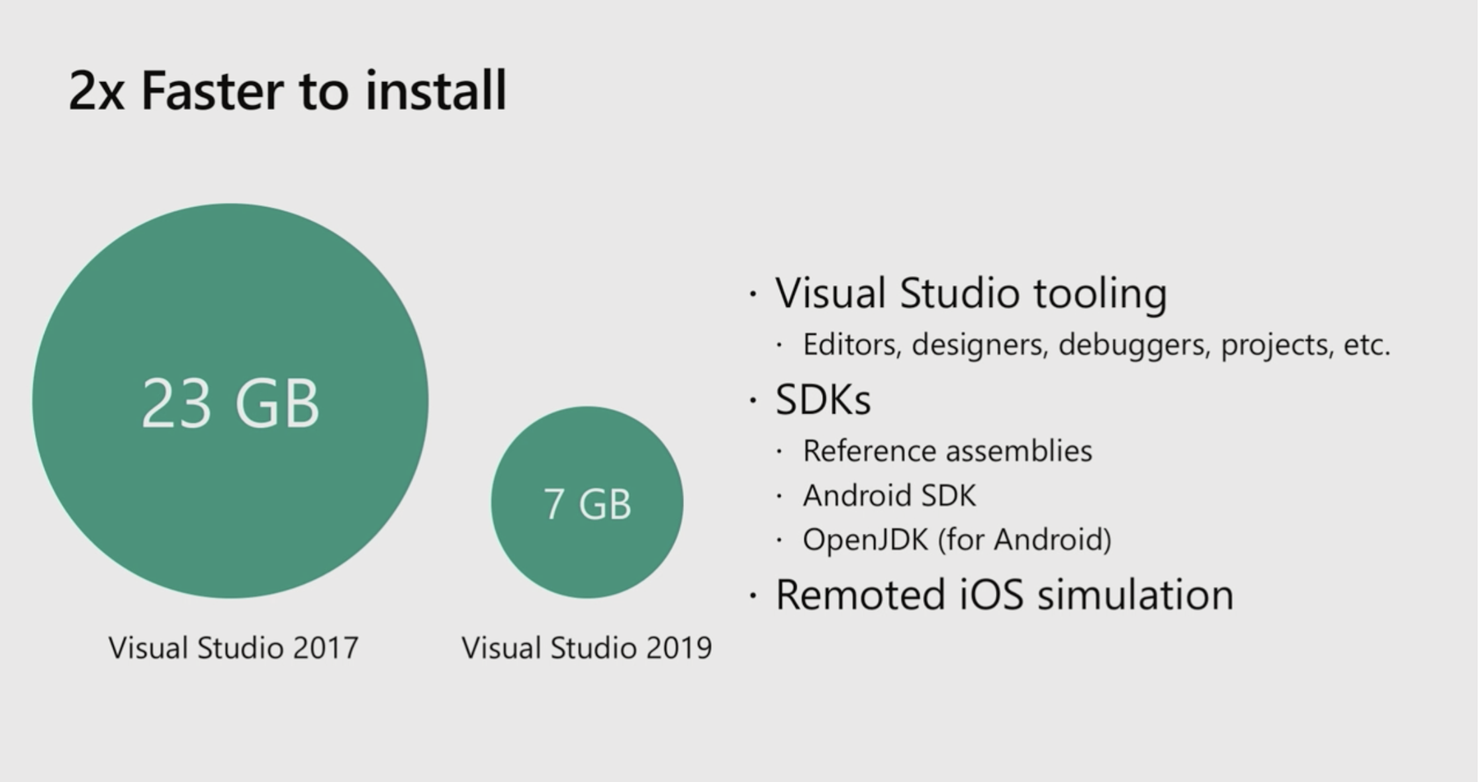
Xamarin

Slide 24
Xamarin – Visual
Consistent UI Layout across platforms
Material Design Visual – Unified look and feel of Material Design across iOS and Android.
Install Nuget package
Initialize Material Renderers
Set Visual Property:
<ContentPage Visual="Material"
...>
...
</ContentPage>
Button
Entry
Frame
ProgressBar
DatePicker
TimePicker
Picker
ActivityIndicator
Editor
Slider
Stepper

Slide 25
Xamarin – CollectionView
Flexible and more performance than ListView
Available in Xamarin.Forms 4.0 pre-releases:
Forms.SetFlags("CollectionView_Experimental");
Allows data to be presented vertically or horizontally, in a list or a grid.
Supports single and multiple selection
Has no concept of cells. Instead, a data template is used to define the appearance of each item of data in the list.
Reduces the API surface of ListView. Many properties and events from ListView are not present in CollectionView.
Does not include built-in separators.

Slide 26
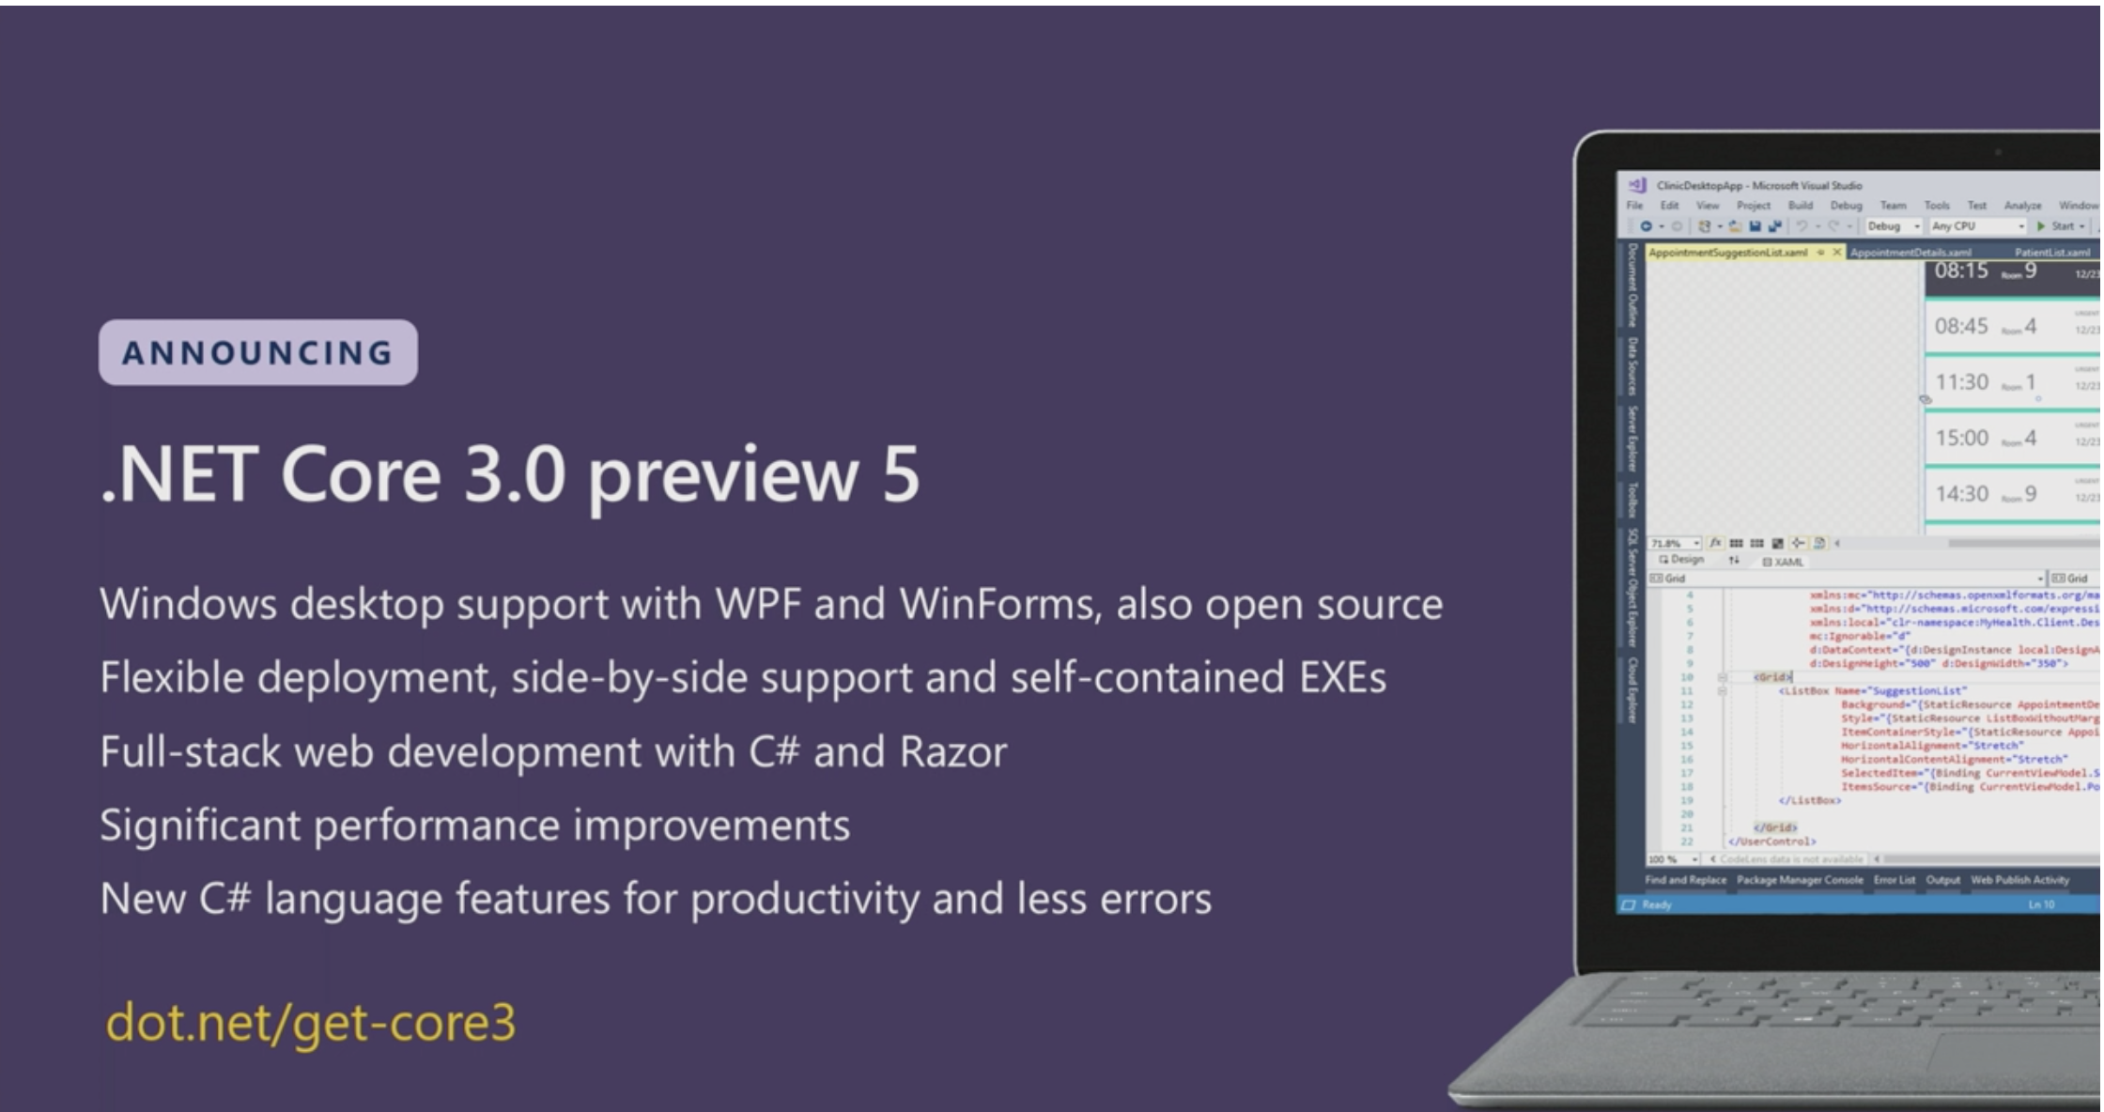
.NET Core 3.0

Slide 27
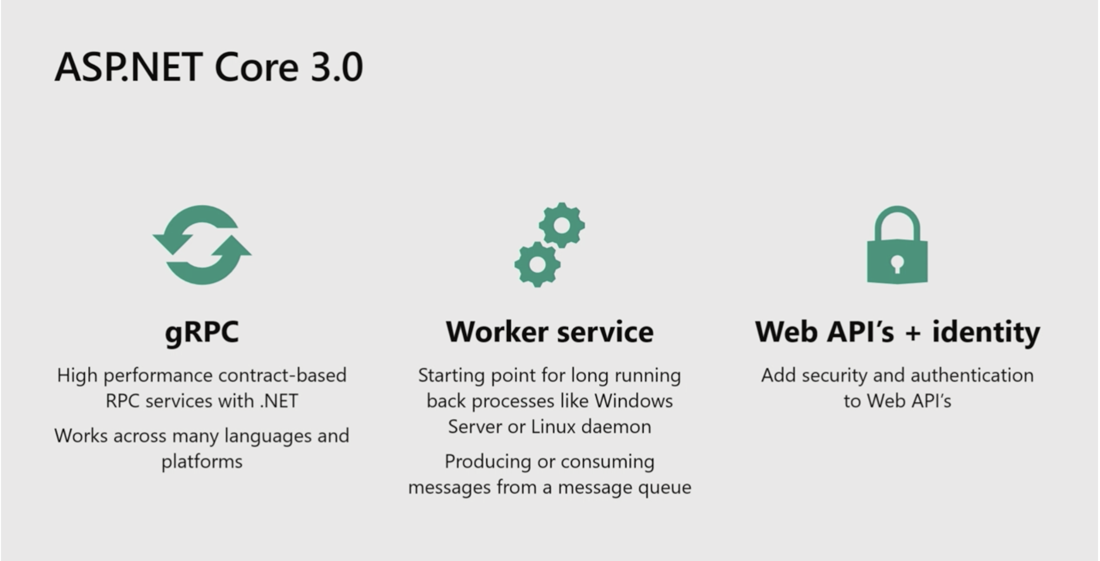
.NET Core 3.0

Slide 28
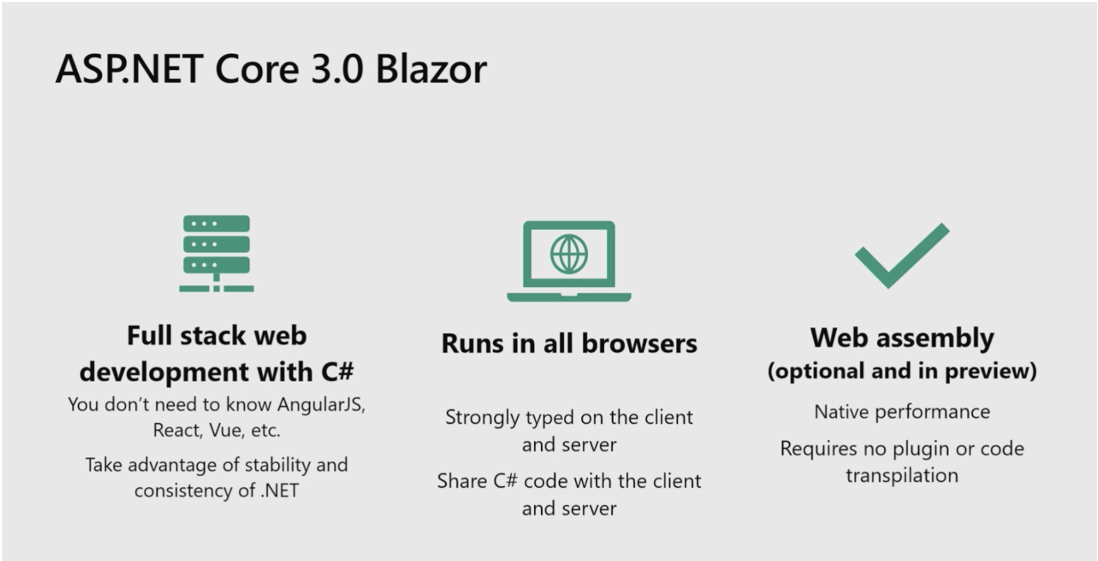
Blazor

Slide 29
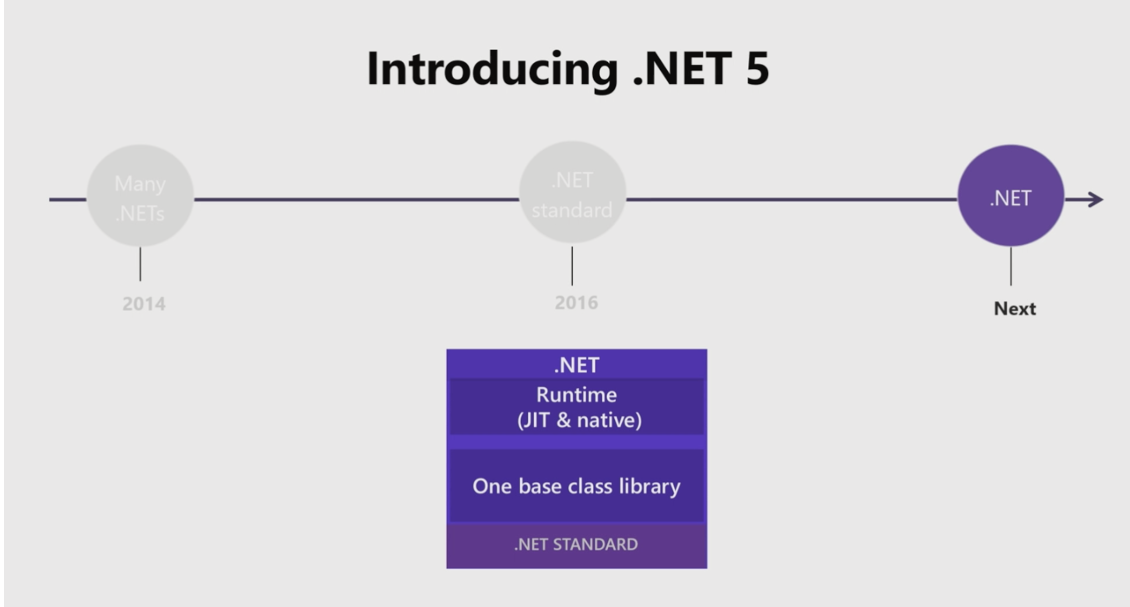
.NET 5

Slide 30
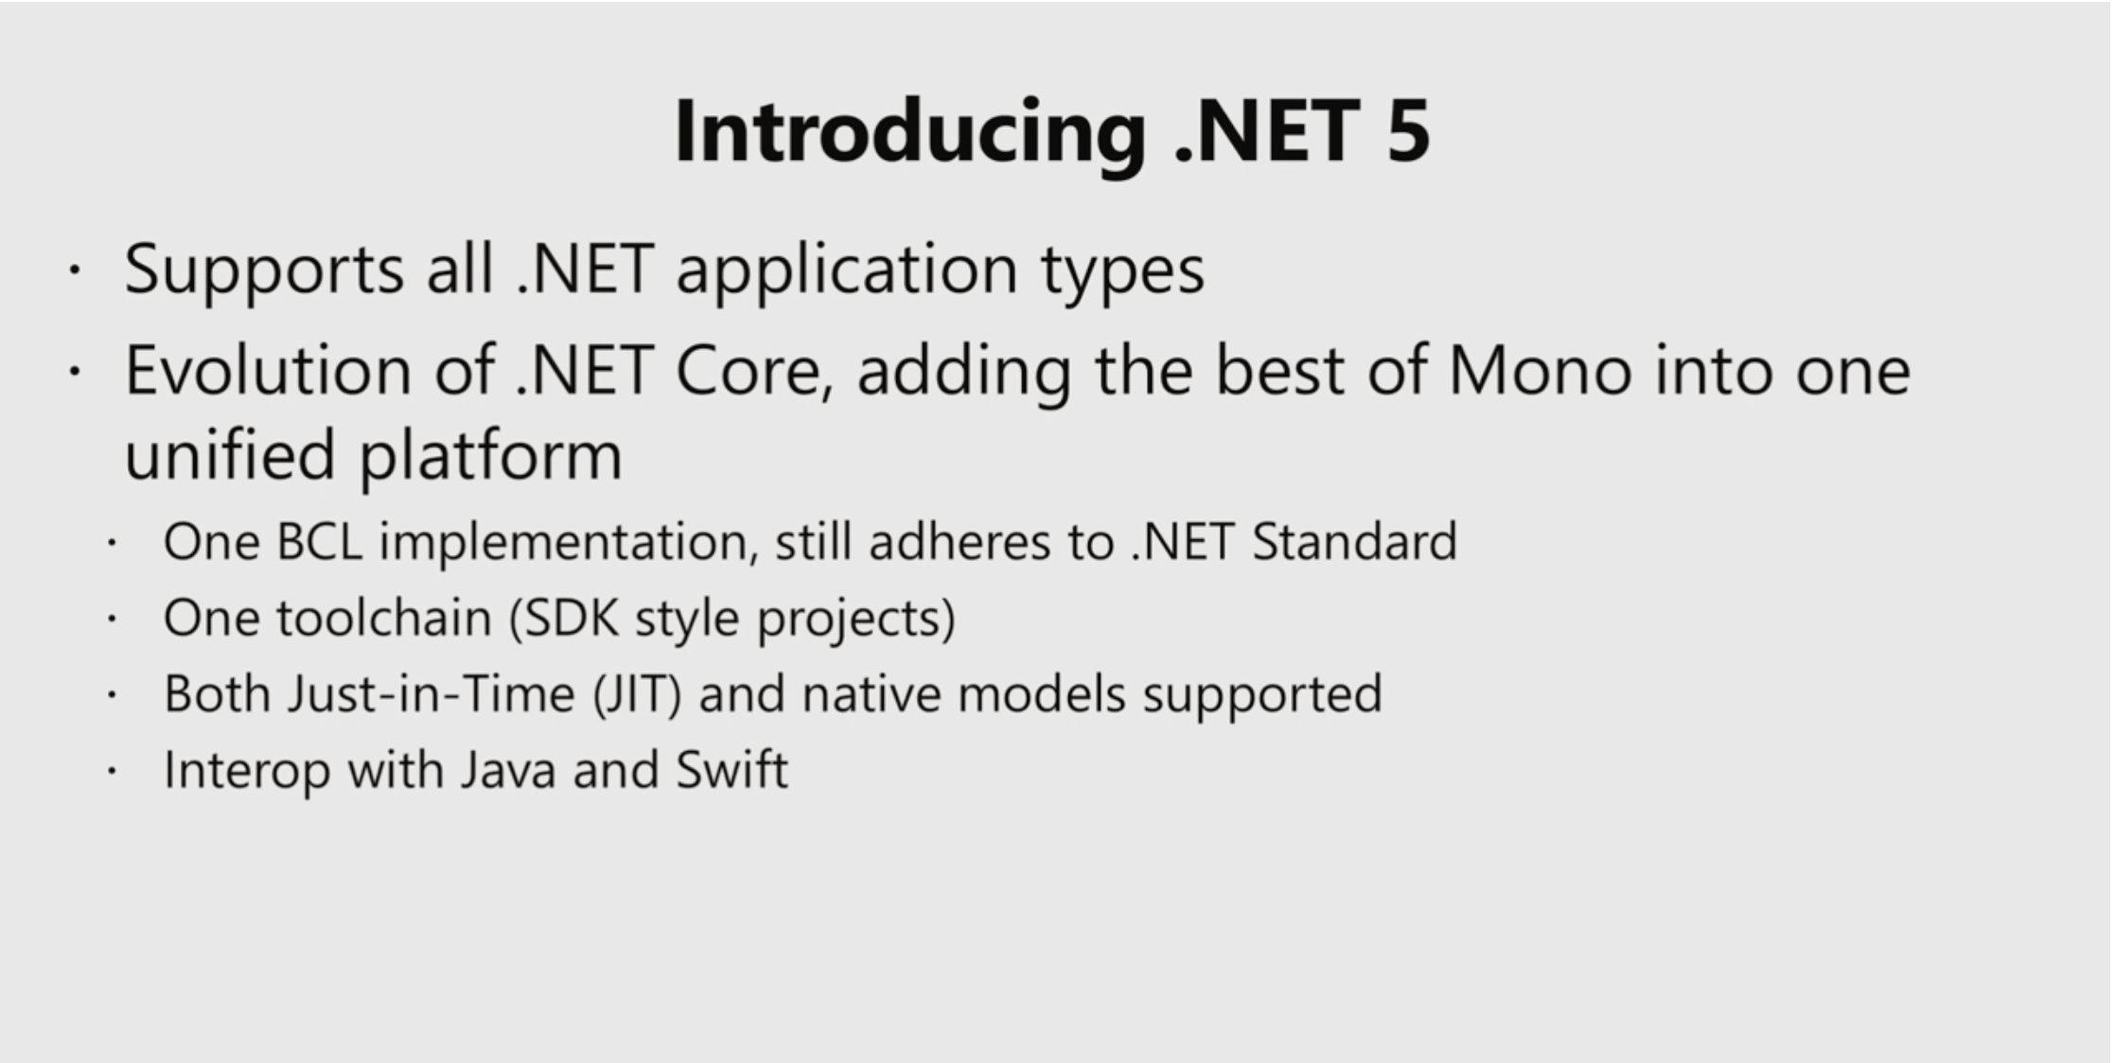
.NET 5

Slide 31
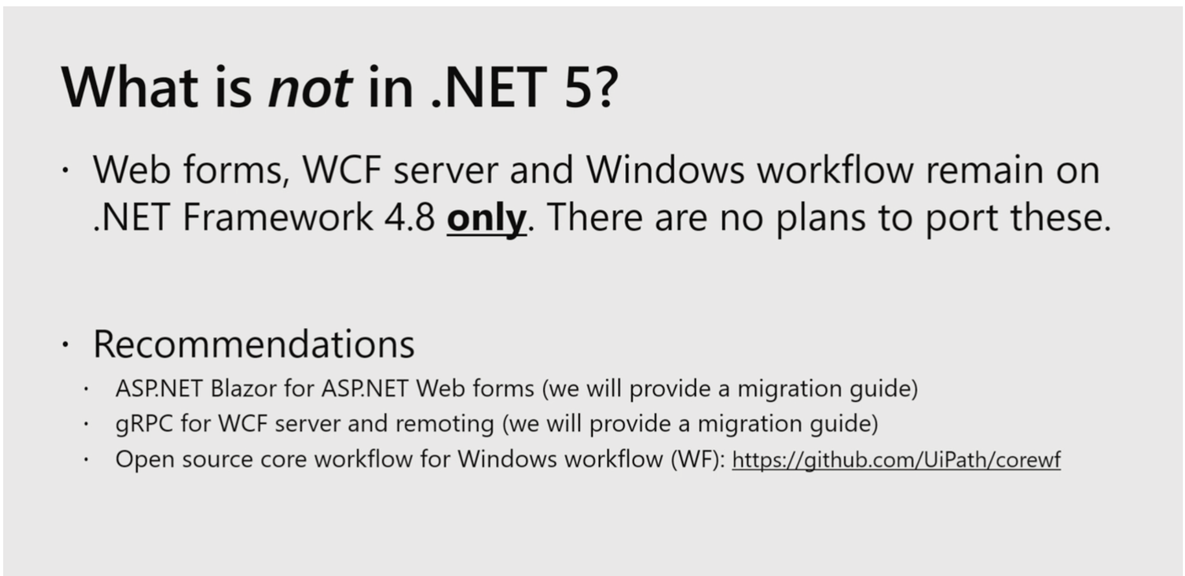
.NET 5

Slide 32
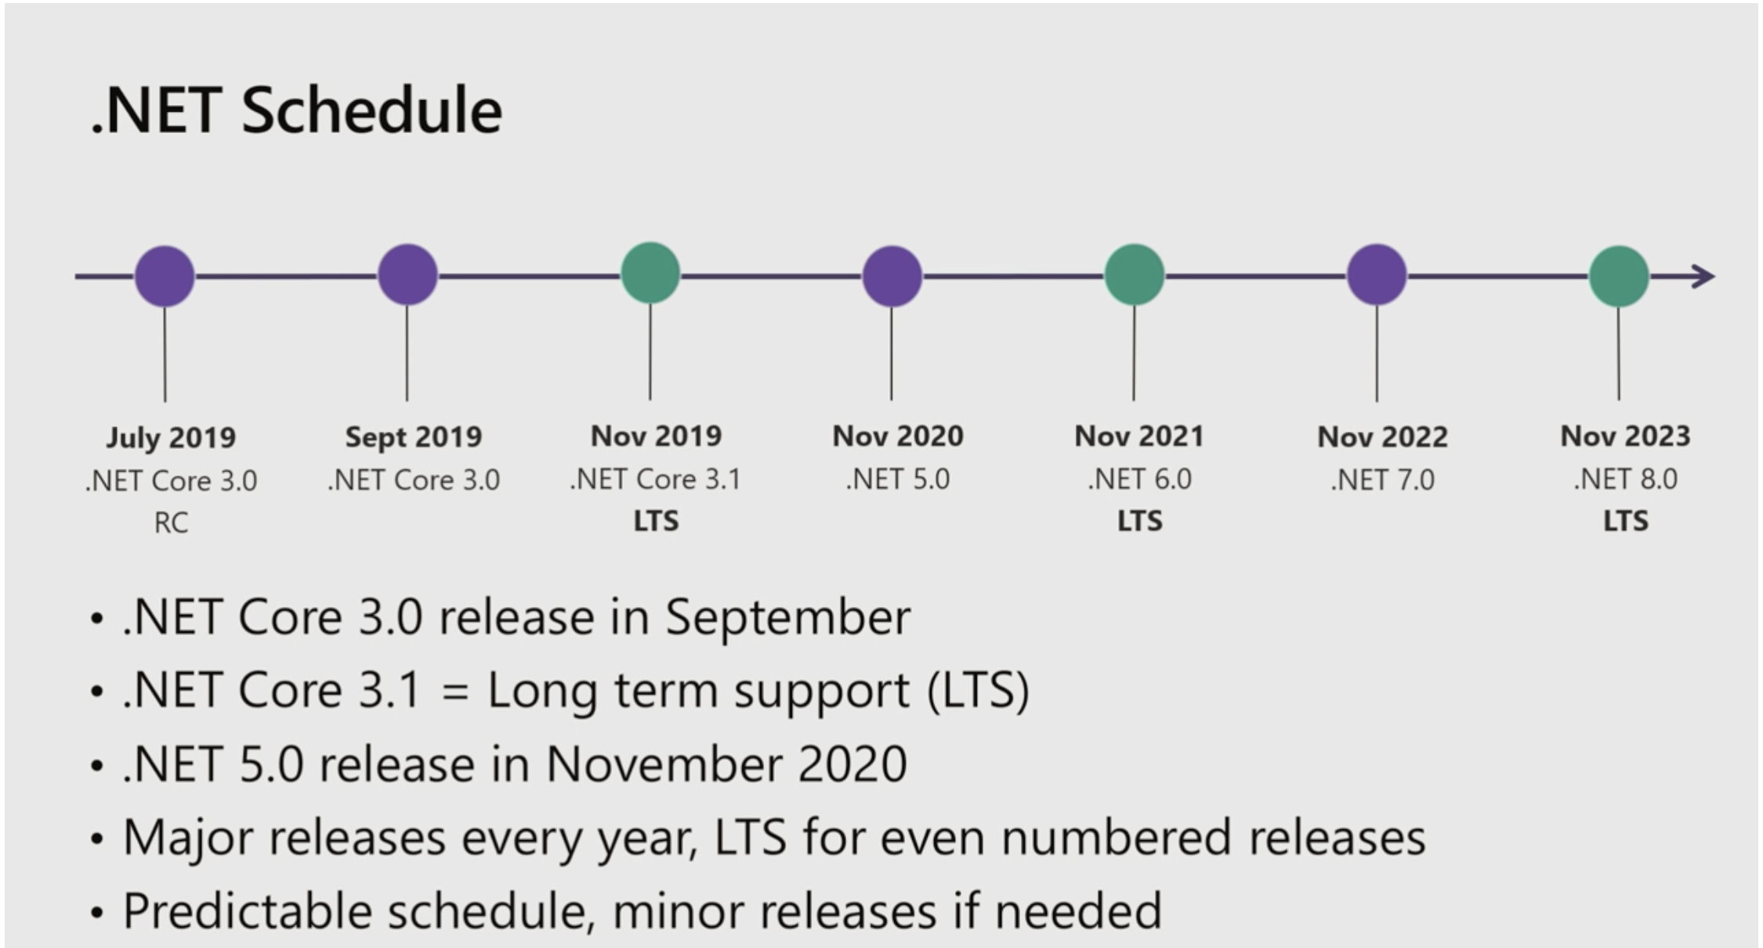
.NET Roadmap

Slide 33
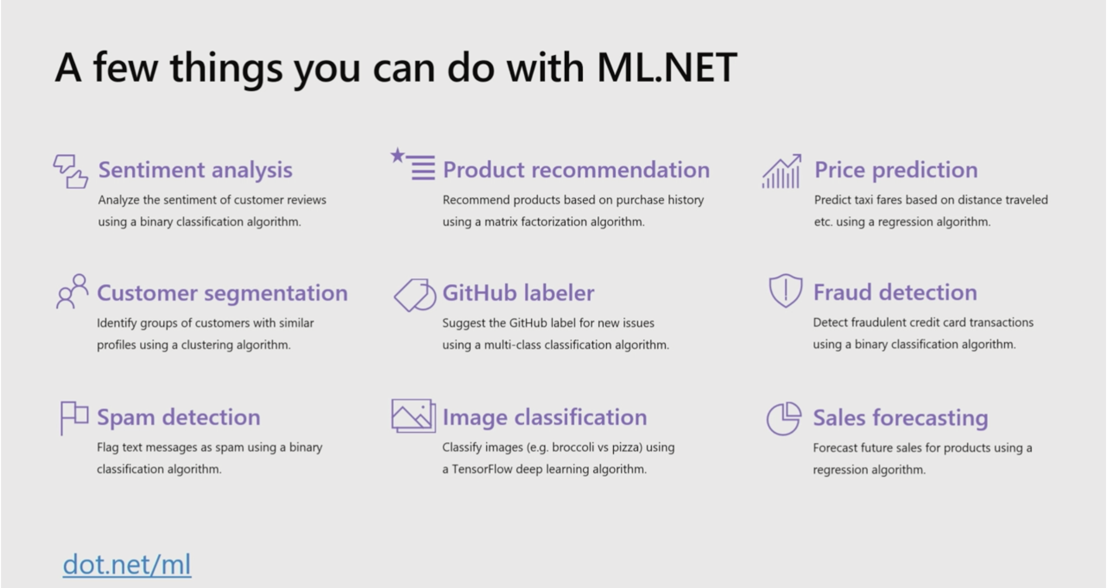
ML.NET 1.0

Slide 34
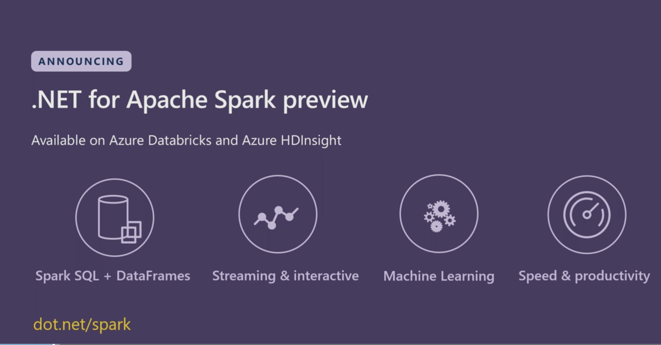
Spark.NET

Slide 35
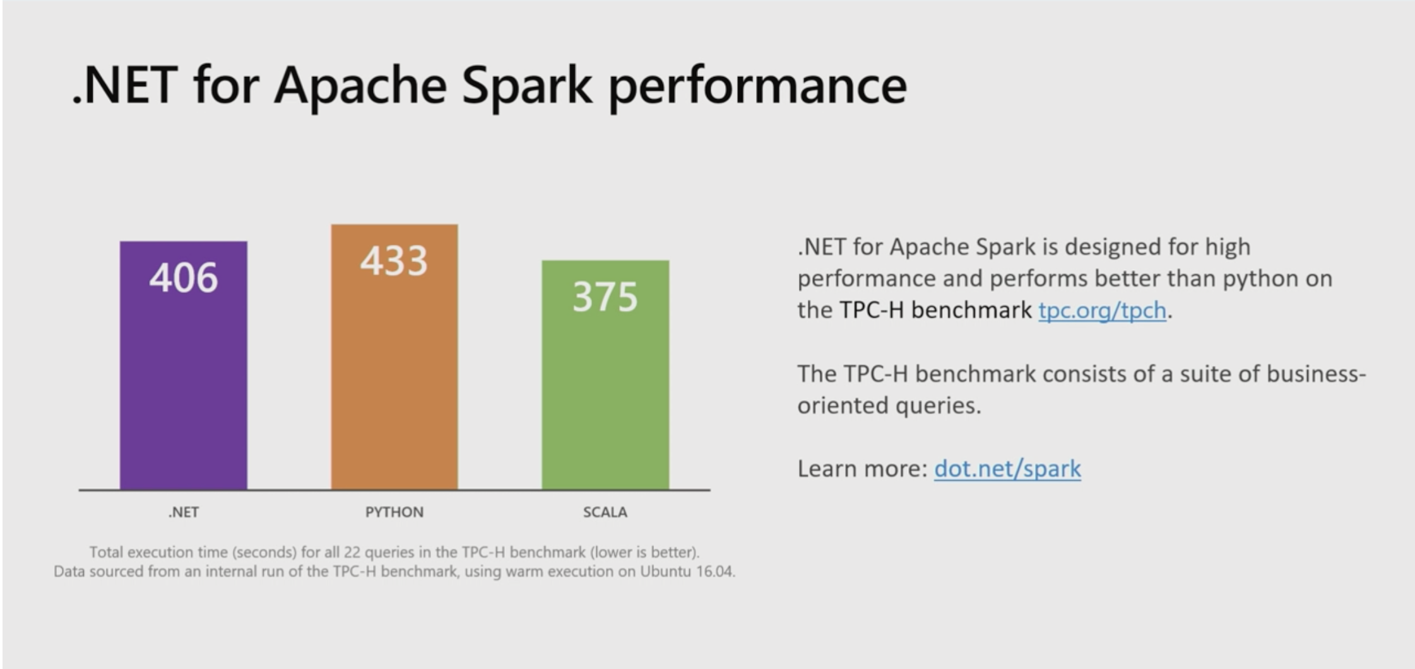
Spark.NET

Slide 36
Windows Terminal
Windows Terminal is a new, modern, fast, efficient, powerful, and productive terminal application for users of command-line tools and shells like Command Prompt, PowerShell, and WSL
Summer 2019 release (preview), Winter 2019 (1.0)

Slide 37
Windows Subsystem for Linux 2 (WSL 2)
Ships Linux Kernel with Windows out of the box
Increased file system performance
Full system call compatibility (can run Docker and FUSE)
Initial builds of WSL 2 will be available through the Windows insider program by the end of June 2019

Slide 38
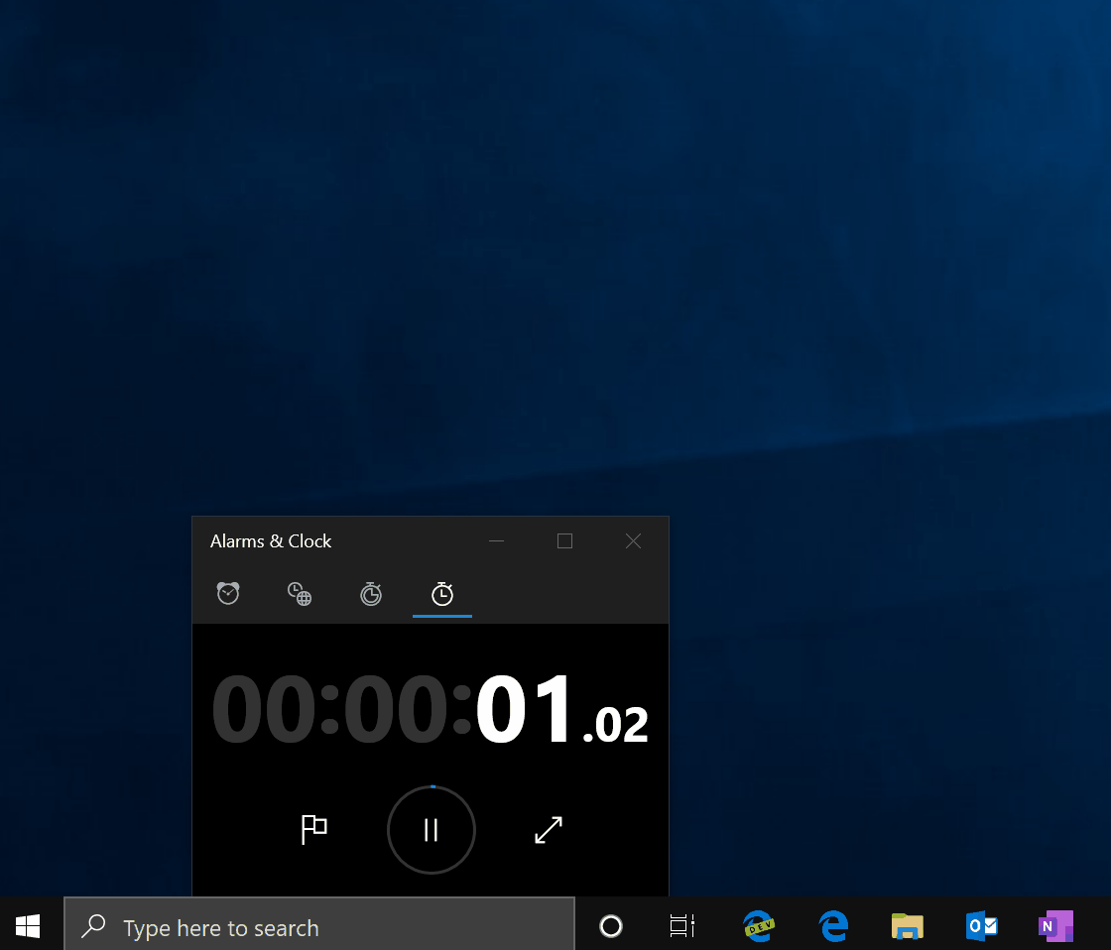
Windows Subsystem for Linux 2 (WSL 2)

Slide 39
React Native for Windows
Microsoft is reimplementing React Native and rewriting many components in C++ to get maximum performance
It allows developers to target any Windows 10 device, including PCs, tablets, Xbox, mixed reality devices and more.
https://github.com/microsoft/react-native-windows

Slide 40
Chromium Edge Browser “Edgium”
Microsoft Edge for Windows:
Support for installable, standards-based Progressive Web Apps which you can inspect and debug using the browser developer tools
Collections
IE Mode
Privacy Tools
Microsoft Edge Canary channel for macOS:
Providing useful and contextual actions through the Touch Bar
Native look and feel of Mac OSX

Slide 41
C# 8.0
Ranges
Nullable Reference Types
Async Streams
Switch Expressions

Slide 42
Ranges - C# 8.0
This feature is about delivering two new operators (Index operator ‘^’ and range operator ‘..’) that allow constructing System.Index and System.Range objects and using them to index or slice collections at runtime.
var lastItem = array[^1];
var lastItem = array[collection.Count-1];

Slide 43
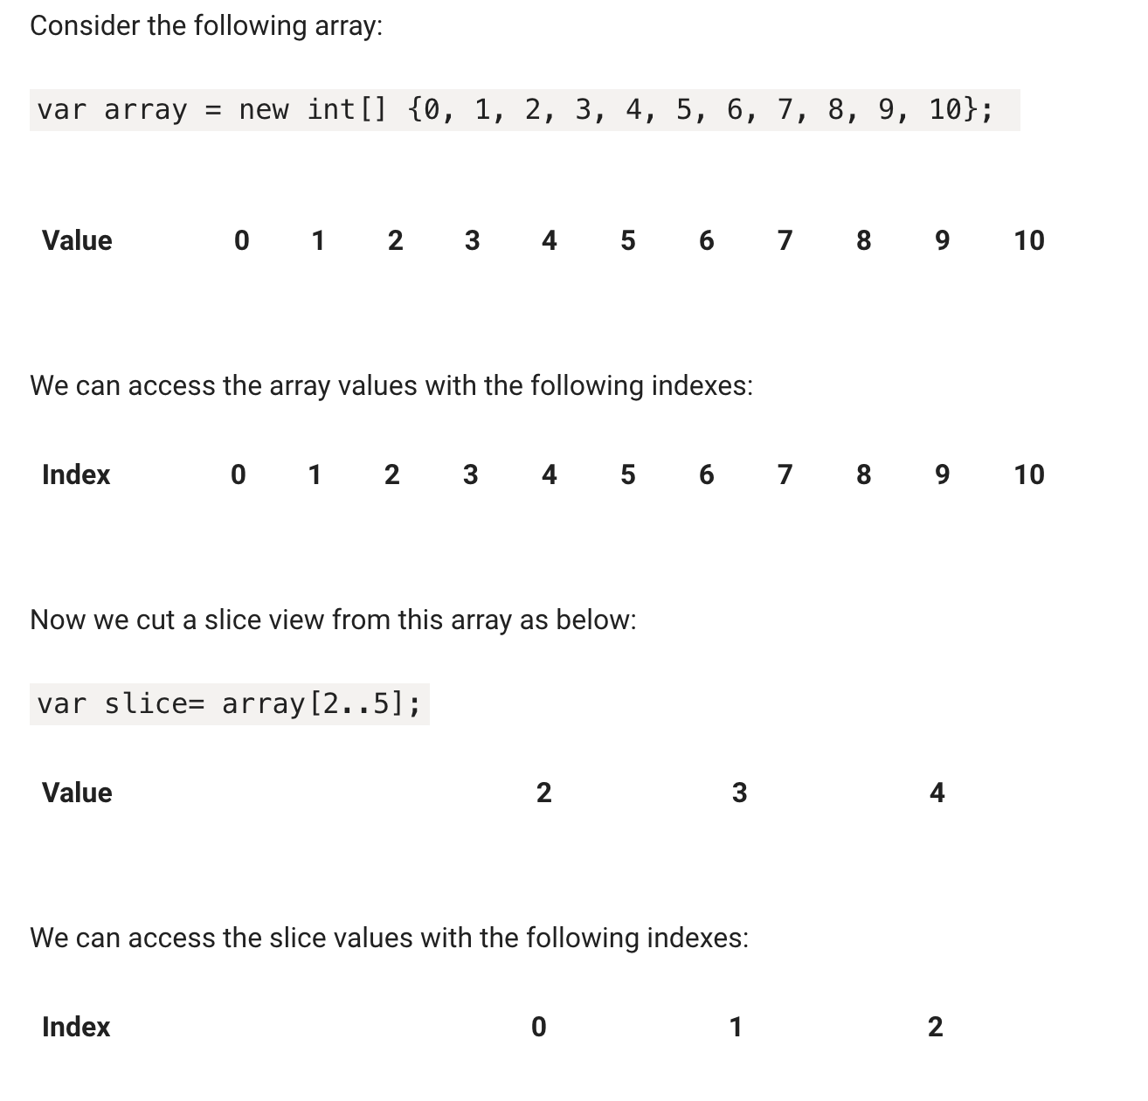
Ranges – C#8.0

Slide 44
Nullable Reference Types - C# 8.0
Compiler gives you warnings for possible null values
To fix warning, just use the nullable value type (?) operator and append to variable type.
string? name;
Can turn on the feature for entire project
For isolated code snippets, use new directive:
#nullable enable
Can override warning by using null forgiving operator(!) following a variable name.
name!.Length;

Slide 45
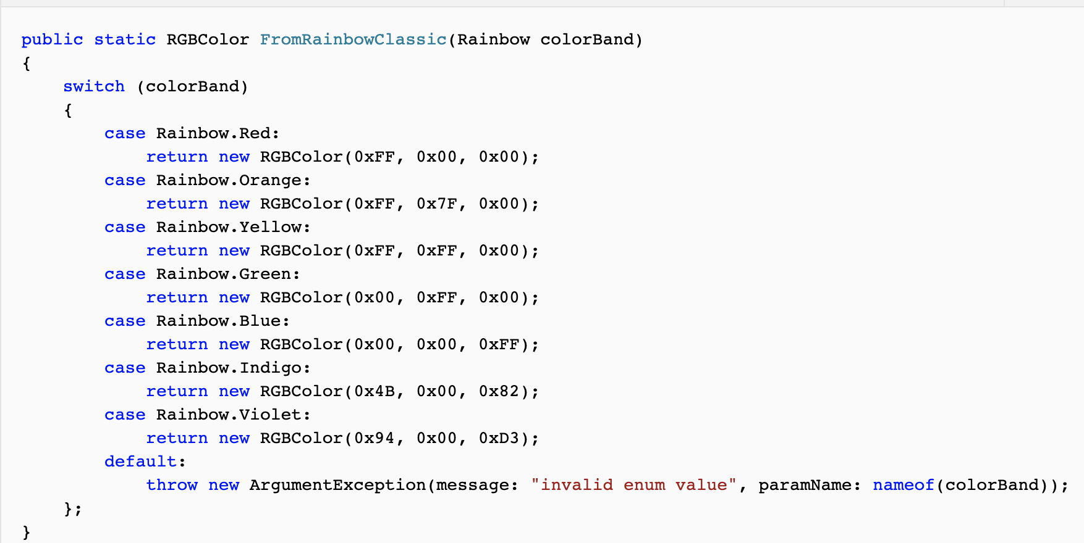
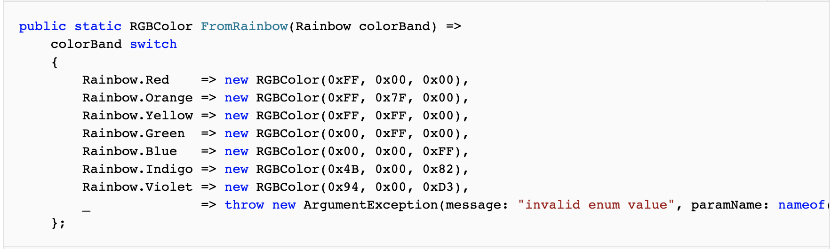
Switch Expressions - C# 8.0
There are fewer repetitive case and break keywords, and fewer curly braces.

Slide 46


Slide 47

https://buildtogether2019.splashthat.com/

Slide 48
Join Our Slack!
http://bit.ly/nycmobiledotnet

Slide 49


Reactor NYC
@MSFTReactor
#ReactorNYC
How was your Meeting?

Slide 50

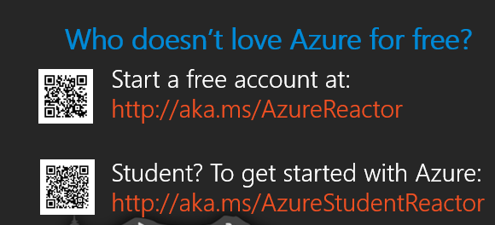

Reactor NYC
@MSFTReactor
#ReactorNYC

